Slide 1
Domain Driven Design for decoupling monoliths
Berlin DevFest 2019 Magomed Chatuev Software Engineer twitter: @magomed_chatuev telegram: @mchatuev

Slide 2
Microservices
Applications built from microservices aim to be as decoupled and as cohesive as possible – they own their own domain logic [that applies to their part of the business problem], and act more as filters in the classical Unix sense – receiving a request, applying logic as appropriate and producing a response.
Martin Fowler

Slide 3
Domain Driven Design
DDD is primarily about modeling a
Ubiquitous Language
in an explicitly defined
Bounded Context

Slide 4
DDD strategic patterns
Bounded Context is a semantic contextual boundary. Within the boundary each component of the software model has a specific meaning and does specific things. The components inside a Bounded Context are context specific.
The software model inside the context boundary reflects a language that is developed by the team working in the Bounded Context and is spoken by every member of the team. The language is called the Ubiquitous Language

Slide 5
Event Storming
to discover Business Domain and its most effective areas for improvements;
to bring people with the questions and knowledge holders who know the answers in the same room and build a model together.
to design the model, which is perfectly aligned with a Domain-Driven Design implementation style and allows for a quick determination of Context and Aggregate boundaries.

Slide 6
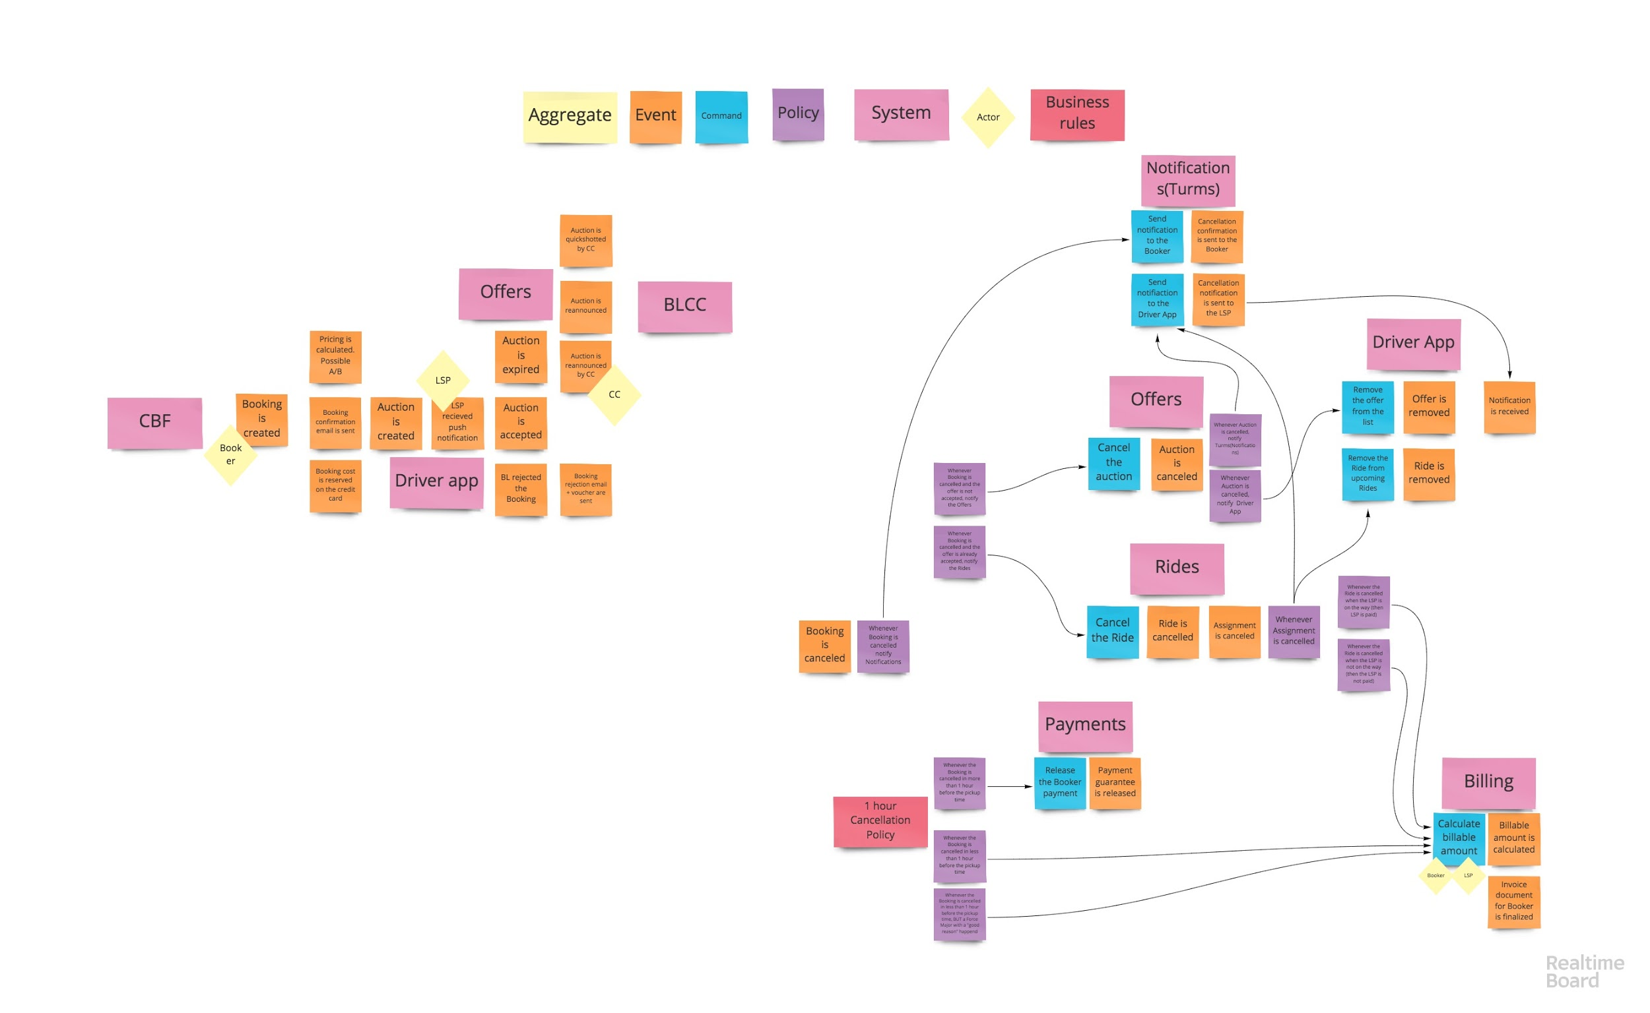
Event Storming example: Bookings subdomain

Slide 7
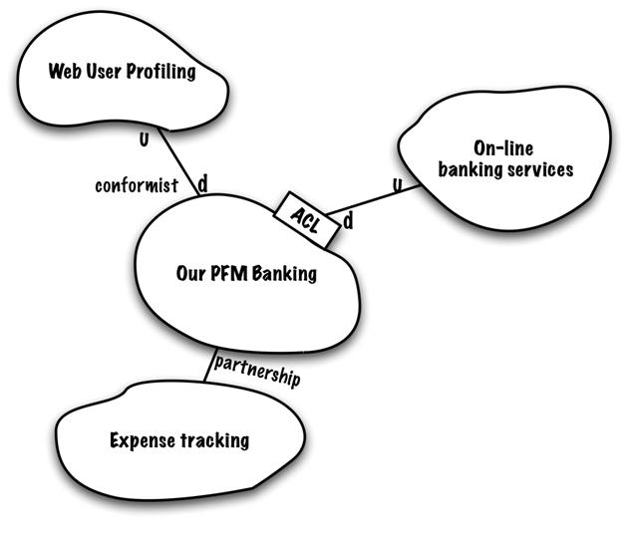
Context mapping
Context mapping is a topology of communication of subdomains in their defined contexts.

Slide 8
DDD tactical patterns. Aggregate
Aggregate is a cluster of domain objects that can be treated as a single unit.
An example may be an order and its line-items, these will be separate objects, but it's useful to treat the order (together with its line items) as a single aggregate.
Martin Fowler

Slide 9
DDD tactical patterns. Entities and Value Objects
Entity: Objects that have a distinct identity that runs through time and different representations.
E.g. Booking, Auction/Offer, Money banknote
Value Object: Objects that matter only as the combination of their attributes. Two value objects with the same values for all their attributes are considered equal.
E.g. Date, Money value

Slide 10
Microservice boundaries
Depending on the size, a microservice could be build as a Subdomain or just an Aggregate in a single bounded context

Slide 11
Real-life example: User Account
Ubiquitous Language
Go Show - immediate/short term Booking Request done by business or 1st class flight travellers in an airport via ASM
ASM(Airport Station Manager) - a manager at a standesc in an airport
Third-party Booking - a booking done by a registered User to an unregistered third-party
PNR(Personal Name Record) - an ID, created by flight-operator, and used by BL match Passenger to a Booking

Slide 16
Subdomains and Roles
Blacklane Account
PASS
B2C
Subdomain
Context
B4B
Emirates
Role
Context
Passenger
Booker
3rdParty

Slide 17
Roles and Contexts Intersections
Role
Context
Subdomain
Context
PASS
Passenger
B2C
Booker
B4B
3rdParty
Emirates

Slide 18
User Account
User
User
Common Account Data
B2C Account
User
User
3rdParty Account
B4B Account
PASS Account

Slide 19
Thank you!
& Let’s keep in touch
twitter: @magomed_chatuev telegram: @mchatuev

